Slide 1
Project 3 Presentation: Trajectories of Onset of Memory/Cognitive Loss
Rachel Johnson

Slide 2
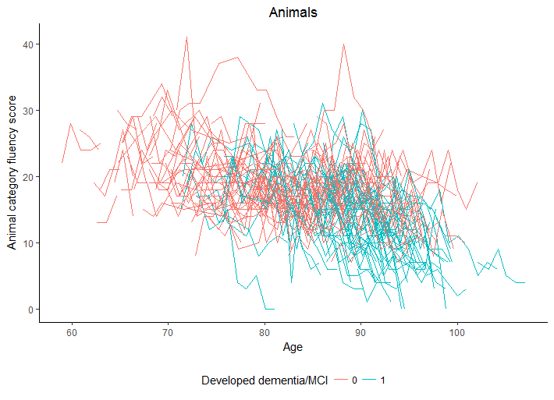
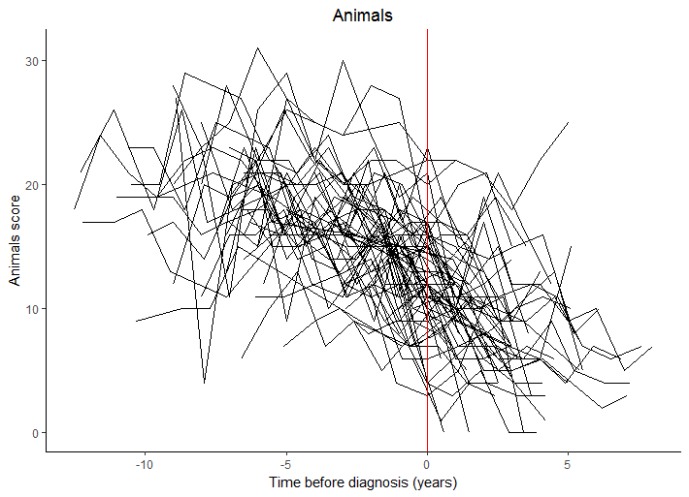
Data Summary
Goal: identify trajectory of onset of memory/cognitive loss in healthy, cognitively-intact elders
Memory/cognitive scores measured for category fluency for animals
216 individuals entered study, only included those with 3+ measurements on outcome (n =187)

Slide 3
 |  |  | Overall | Did not develop dementia/MCI during study | Developed dementia/MCI during study
n |  |  | 187 | 119 | 68
Number observations (mean (sd)) |  |  | 17.49 (7.48) | 16.42 (8.22) | 19.35 (5.54)
Years of follow-up (mean (sd)) |  |  | 8.82 (4.05) | 8.23 (4.41) | 9.87 (3.08)
Gender (%) |  | Male | 82 (43.9) | 59 (49.6) | 23 (33.8)
 |  | Female | 105 (56.1) | 60 (50.4) | 45 (66.2)
SES (mean (sd)) |  |  | 49.32 (11.68) | 49.66 (10.86) | 48.74 (13.07)
Age (mean (sd)) |  |  | 80.10 (8.87) | 77.16 (8.92) | 85.24 (6.01)
BlockR (mean (sd)) |  |  | 24.56 (9.36) | 26.52 (9.43) | 21.12 (8.22)
Animals (mean (sd)) |  |  | 17.33 (5.11) | 18.30 (4.99) | 15.62 (4.91)
LogMemI (mean (sd)) |  |  | 13.48 (4.36) | 14.60 (4.02) | 11.53 (4.28)
LogMemII (mean (sd)) |  |  | 11.13 (5.00) | 12.55 (4.51) | 8.65 (4.88)

Slide 4
Data Analysis Plan
Model category fluency for animals score over time
Adjust for dementia status, age adjusted (age – minimum age of 59), interaction between dementia status/age, SES, gender, maximum of 0 & difference between age at visit and dementia onset (if applicable) & change point
Included random intercept to account for repeated measures
Included spatial power covariance structure to account for uneven visit times
Determined change point with maximum likelihood methods by testing variety of change points
Bootstrapped change point and estimates from mixed model
Found 95% CI for change point
Found new standard errors, p-values for estimates from model

Slide 5
Analysis Results
Variable | Model Estimate | Bootstrapped Standard Error | p-value
Intercept | 24.59 | 2.9 | <0.0001
Change Point | -0.93 | 0.15 | <0.0001
Gender (ref = M) | -0.56 | 0.57 | 0.3311
SES | 0.04 | 0.02 | 0.0811
Age - 59 | -0.18 | 0.03 | <0.0001
Dementia (ref = 0) | -4.39 | 2.81 | 0.1187
Interaction | 0.01 | 0.09 | 0.9493
Change Point (likelihood) | Change point (bootstrap) | Bootstrapped 95% CI
-3.9 | -4.05 | -5.5, -2.6

Slide 6
Conclusions & Limitations
What is the rate of memory decline based on these measures over the aging process in healthy individuals?
Mean decrease of 0.18 points per 1 year increase in age (95% CI: -0.24, -0.12)
What is the rate of memory decline based on these measures over the aging process in those diagnosed with MCI/dementia during the study?
Mean decrease of 0.17 points per 1 year increase in age before change-point
Mean decrease of 0.17+0.93 = 1.10 points per 1 year age increase after
Is there a period of time before the diagnosis of MCI/dementia in which the rate of the memory decline changes (or accelerates)?
Memory decline changes 3.9 years before diagnosis (95% CI: -5.5, -2.6)
Limitations: had to exclude 29 individuals w/ <3 measurements

